Slide 1
Integrated Project
Oratile Tlholoe 2024

Slide 2
Overview
Project Landscape
Trello Board
PowerBi
GitHub

Slide 3
Project Landscape
 | Data | Information | Knowledge
Underwriting engine | What types of data are collected during the underwriting process? | How is the collected data structured and organized for underwriting analysis? | How are underwriting rules and guidelines developed based on data analysis?
Risk Price | How are data quality and completeness ensured for accurate risk pricing? | What methods are employed to analyze the relationship between risk factors and insurance premiums? | What insights are derived from analyzing market trends and competitor pricing strategies?
Margin | What factors influence the accuracy of margin estimation? | How are margin forecasts generated based on historical financial data? | How is strategic decision-making influenced by expert knowledge of market dynamics and economic conditions?

Slide 4
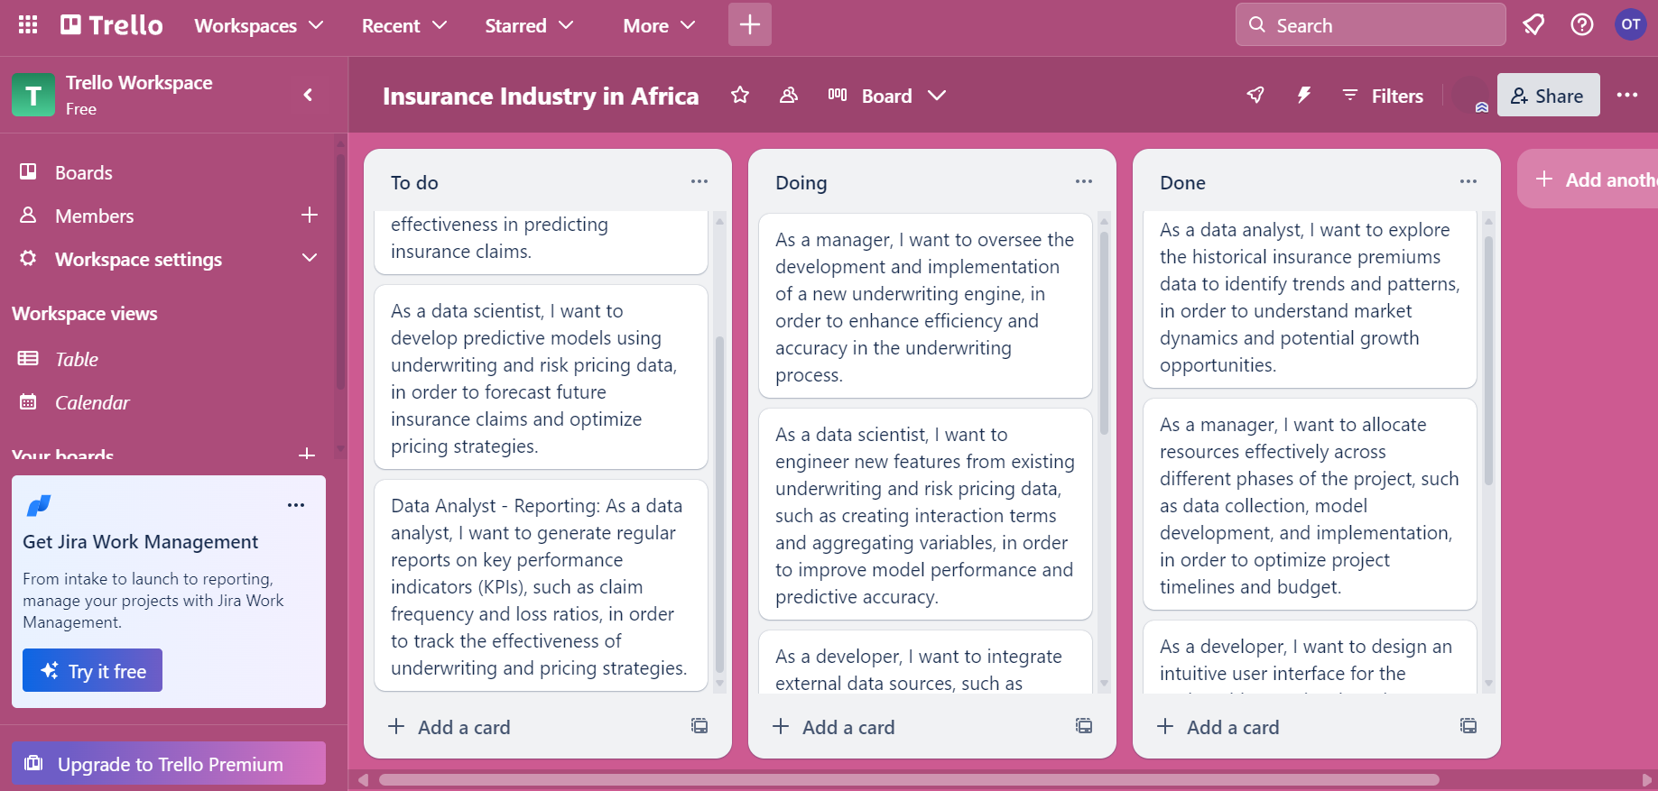
Trello Board

Slide 5
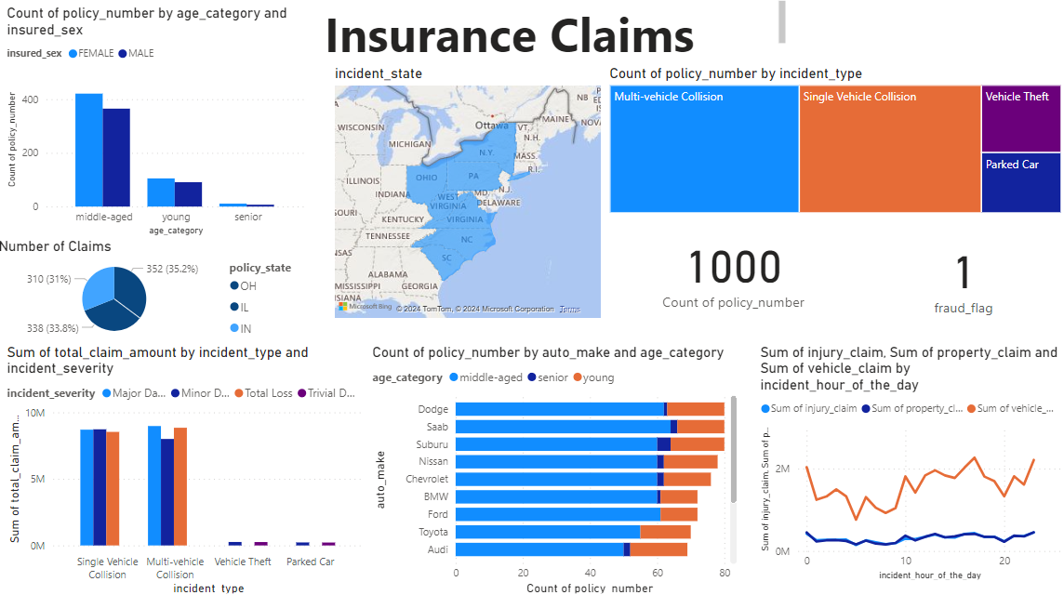
Power Bi Dashboard

Slide 6
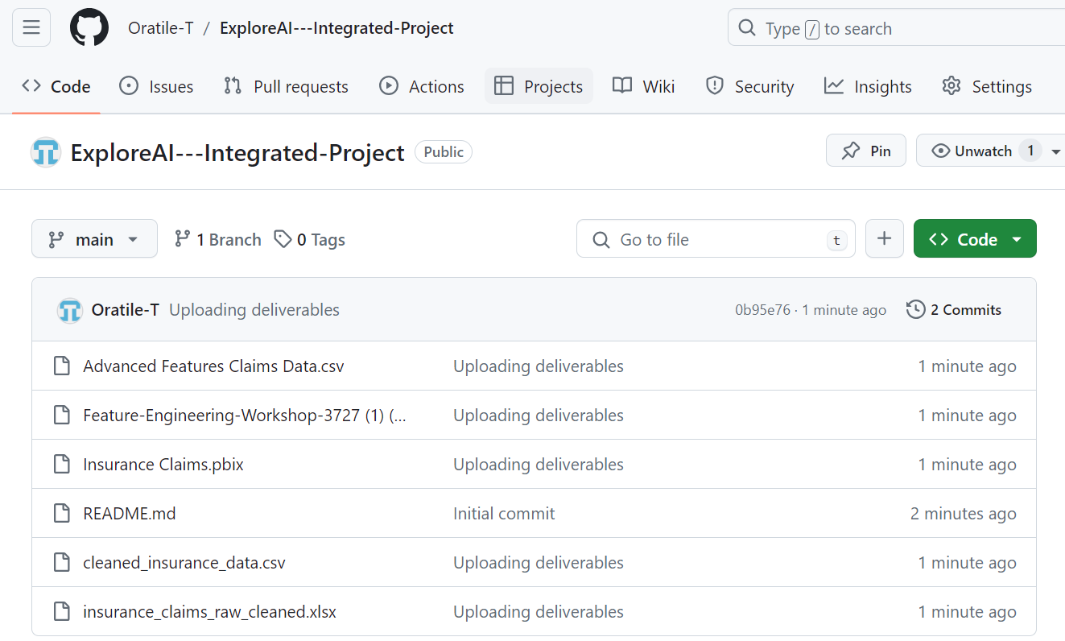
GitHub
Oratile-T/ExploreAI---Integrated-Project (github.com)

